Slide 1
Navod neranjan thilakarathne Faculty of Integrated Technologies Universiti Brunei Darussalam Brunei Darusalam
Kasorn Galajit NECTEC, National Science and Technology Development Agency, Pathum Thani, Thailand Candy Olivia Mawalim Japan Advanced Institute of Science and Technology,Ishikawa, Japan
Hayati Yassin Faculty of Integrated Technologies Universiti Brunei Darussalam Brunei Darusalam
Exploring a Cutting-Edge Convolutional Neural Network for Speech Emotion Recognition

Slide 2
Human speech continues to be one of the most abundant and easily obtainable reservoirs of emotional indicators.
Hence , Speech Emotion Recognition (SER) has emerged as a critical component in enabling intelligent systems to comprehend the meaning of human emotions.
SER is the process of extracting emotional states from spoken language and categorizing them with the goal of interpreting the intricate emotional states present in spoken language so that machines can recognize a variety of emotions, such as joy, grief, rage, and others
The accurate identification of emotions in speech data continues to be a multifaceted and ever-changing obstacle, demanding techniques capable of capturing the subtle dynamics, patterns, and contextual information that are inherent in audio signals
As per the current status of SER research, a range of strategies have been employed, for speech analysis and classification.
Background of the Research
Notes:
Speech emotion recognition (SER) is a field of artificial intelligence (AI) that deals with identifying emotions from a person's voice. It analyzes things like pitch, tone, and rhythm to classify the speaker's emotional state.

Slide 3
Background of the Research
SER is comprised of two phases: feature extraction and feature classification
For the extraction of features, various technologies are used, such as acoustic feature extraction (involves analyzing various speech characteristics like pitch, tone, and speed through techniques like Mel-Frequency Cepstral Coefficients (MFCCs)), prosodic analysis (refers to the analysis of rhythm, stress, and intonation of speech) and spectral analysis (involves examining the frequency spectrum of speech through techniques like Fourier Transform).
Once the features are extracted, the next step involves classifying them into distinct emotions, which employs ML and DL techniques .
The commonly used machine learning algorithms include Support Vector Machine, K-Nearest Neighbor, and Decision Tree, where DL techniques, including Recurrent Neural Networks (RNNs) and CNNs.
In recent years, DL has drawn more interest and is seen to be a developing subject of study in SER.
According to the state-of-the-art , CNN demonstrated better discriminative performance compared to other DL architectures employed and often outperformed traditional methods employed for SER.
Notes:
Spectral analysis is a technique which estimates the power. of a signal at different frequencies. The
The voiced speech of a typical adult male will have a fundamental frequency from 90 to 155 Hz, and that of a typical adult female from 165 to 255 Hz

Slide 4
State of the Art
Reference | Algorithm/technique used | Scope of the study
(Zheng et al., 2015) | CNN | This research presents a methodical approach to the implementation of an efficient emotion identification system that is built on deep CNNs.
(Neumann & Vu, 2017) | CNN | The research involved using an attentive CNN with a multi-view learning objective to assess system performance. This assessment was based on varying the length of the input signal, experimenting with different acoustic feature sets, and analyzing various types of emotionally charged speech.
(Badshah et al., 2017) | CNN | Presents a method for SER using spectrograms and deep CNN.
(Huang et al., 2014) | CNN | The study introduces a method where a semi-CNN is used for learning features that are crucial for emotion detection in speech.
(Lim et al., 2016) | CNN and RNN | The authors have designed a SER model based on CNN and RNN and evaluated on emotional speech data.
(Issa et al., 2020) | CNN | In order to identify emotions, the authors present a novel architecture that utilizes features extracted from sound files, including spectral contrast, chromagram, mel-frequency cepstral coefficients and tonnetz representation, and chromagram, as inputs for a one-dimensional CNN.
(Bertero & Fung, 2017) | CNN | The authors propose a real-time CNN for SER to recognize three emotional states in the study.
(Tzirakis et al., 2018) | CNN and LSTM | The authors present a novel continuous SER model using CNN and LSTM.
(Mao et al., 2014) | CNN | The authors proposed using CNN to discover affect-salient features for SER. Their experimental findings on benchmark datasets demonstrate that the method employed produces consistent and dependable scene recognition performance.
(Zhang et al., 2018) | CNN | The authors investigated how a deep CNN can be utilized to bridge the emotional gap in voice signals.

Slide 5
Key Contributions
Motivated by the fact that designing a more efficient way of identifying emotions through human speech, this study presents a novel CNN architecture for SER. By harnessing the capabilities of DL, this proposed architecture achieves exceptional accuracy in distinguishing human emotions from speech data
Propose a novel CNN model for speech emotion recognition integrating CNN layers with Long Short-Term Memory (LSTM) layers, combining speech data from three distinct datasets for training the underlying model.
Employ data augmentation techniques to improve the generalization of the proposed CNN model and prevent overfitting.

Slide 6
Methodology
The dataset was constructed through the concatenation of data extracted from three distinct databases: the toronto emotional speech set , the crowd-sourced emotional multimodal actors dataset , and the surrey audio-visual expressed emotion database.
The prepared dataset encompasses short voice messages, which include English phrases voiced by professional actors (including both male and female voices), and the data was in the .wav file format.
Data were extracted in a way to contain seven types of emotions: angry, happy, disgust, surprised, sad, and fear.
Final concatenated dataset contains 10722 voice records.

Slide 7
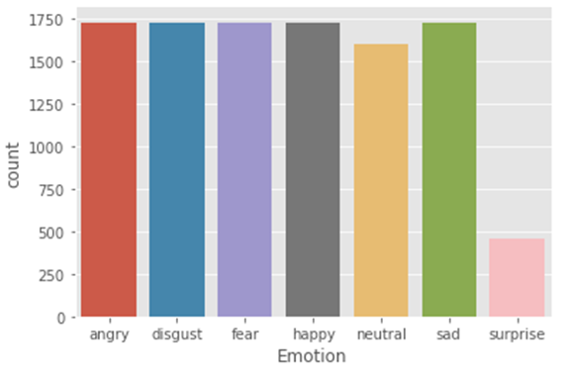
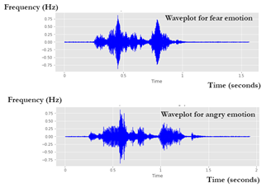
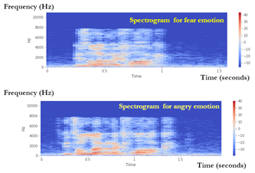
Data Analysis
Emotion surprise was the lowest recorded (from the .wav files)
Wave plots pertaining to fear and angry emotions
Spectrogram pertaining to fear and angry emotions

Slide 8
Data Augmentation
Used to increase the amount of training data and improve the generalization of DL models whilst preventing overfitting.
Random noise was added to the voice samples.
A random noise was generated with the same length as the speech signal.
Afterward, generated noise was added to the original speech signal to create a noisy version.
Overall, adding controlled random noise to the training data can make the model more robust to these variations. It essentially trains the model to recognize the target speech even when partially masked by noise.

Slide 9
Feature Extraction
The Librosa library in Python was used.
MFCC were used
Once the features were extracted, empty values were removed, and NaN values were filled with 0.
Next, label encoding was done to convert emotional states into numerical form, and finally, all the data were standardized using the Python Standard Scaler method. This has been done to ensure that all features have the same scale and mean, which can help improve the performance of the DL model.
Afterward, as the final step, the dataset was divided into 90% for training and 10% for testing.

Slide 10
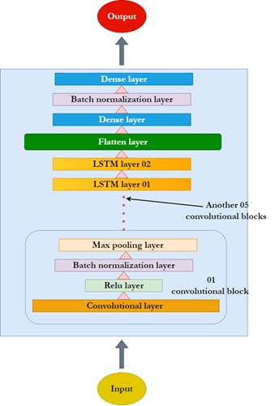
Model Building
Input layer consisted of an initial convolution layer that was composed of 512 filters and a kernel size of 3.
Following the input layer is a convolutional block consisting of a batch normalization and max pooling layer.
Five more blocks are included in the final model, which is subsequently composed of two LSTM layers, a flattened layer, a dense layer with batch normalization, and a dense layer employing a SoftMax activation function.
This has been finalized after several trials with varied combinations of hyperparameters that yield the best results

Slide 11
Evaluation
An accuracy, precision, recall, and F1 scores were recorded
The hyperparameters employed in the model training are highlighted in Table 1.
Overall, we have tried varied combinations of hyperparameters, where the highlighted configurations in Table 1 yield the best results.
A callback function was implemented to terminate model training once the validation set reached the minimum loss threshold, where training loss decreased and showcased a linear loss after the 20th epoch
The execution of the model was terminated at the 34th epoch.
After model training, it was evaluated on a separate test set, and it is evident that it reached a testing accuracy of 88.76 % on test data.
Table 1. hyperparameters employed in the model training
Parameter | Value
Optimizer | Adam
Batch size | 64
Epochs | 34 (early stopping call back used)
Learning rate | 0.001
Loss function | Categorical cross-entropy

Slide 12
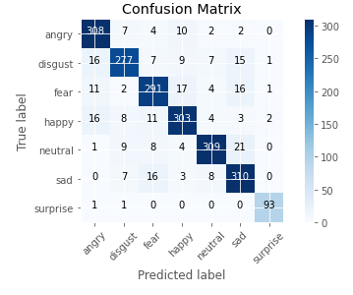
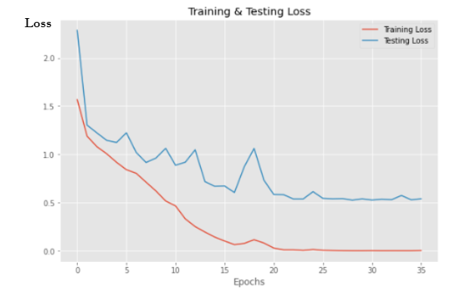
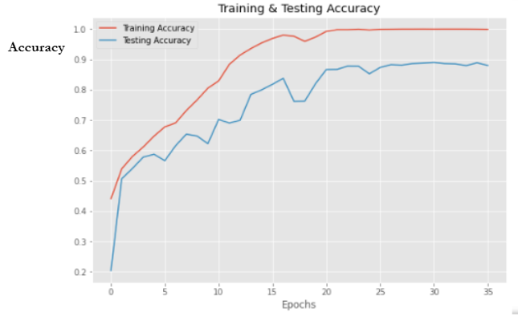
Experiment Results
Performance evaluation metrics
Parameters | Accuracy | Precision | Recall | F1 score
Values (%) | 88.76 | 88.43 | 88.56 | 87.43
Training and testing loss over the number of epochs
Training and testing accuracy over the number of epochs
Confusion Matrix

Slide 13
Validation / Comparison
Reference | Employed classifier | Features employed | Dataset/(s) used | Accuracy (%)
(Zheng et al., 2015) | CNN (02 convolution and 02 pooling layers) | Mel spectrogram | Interactive Emotional Dyadic Motion Capture (IEMOCAP) dataset | 40.00
(Badshah et al., 2017) | CNN ( 03 convolutional and 03 fully connected layers) | Mel spectrogram | Berlin dataset | 84.30
(Lim et al., 2016) | CNN + LSTM ( 04 convolutional layers with the LSTM network) | Short-time fourier transform | Berlin dataset | 88.01 (precision only)
(Bertero & Fung, 2017) | CNN ( one convolutional layer) | Mel spectrogram | TEDLIUM v2 corpus dataset | 66.10
(Zhang Et Al., 2018) | AlexNet pretrained CNN | Mel spectrogram | Berlin database, RML audio-visual dataset, eNTERFACE05 audio-visual dataset and the BAUM-1s audio-visual dataset | 87.31
Our proposed model | Modified CNN | Mel spectrogram | Crowd-sourced emotional multimodal actors dataset, toronto emotional speech dataset, and surrey audio-visual expressed emotion dataset | 88.76

Slide 14
Conclusion
Presents a novel CNN architecture that classifies and evaluates seven distinct emotional states from speech signals, with an accuracy of 88.76 %.
In an era where human-computer interactions must become more emotionally intelligent, the results of this study mark a substantial advancement in utilizing DL to respond to and comprehend human emotions in a variety of technological contexts.
Enhanced through continued development and refinement, this innovative SER approach has the potential to facilitate the creation of digital systems that are more responsive and empathetic, thereby elevating the standard of human-computer interactions across various domains.

Slide 15
THANK YOU

