Slide 1
ICUFN 2022
Efficient Device-Edge Inference for Disaster Classification
Tham Mau Luen

Slide 2
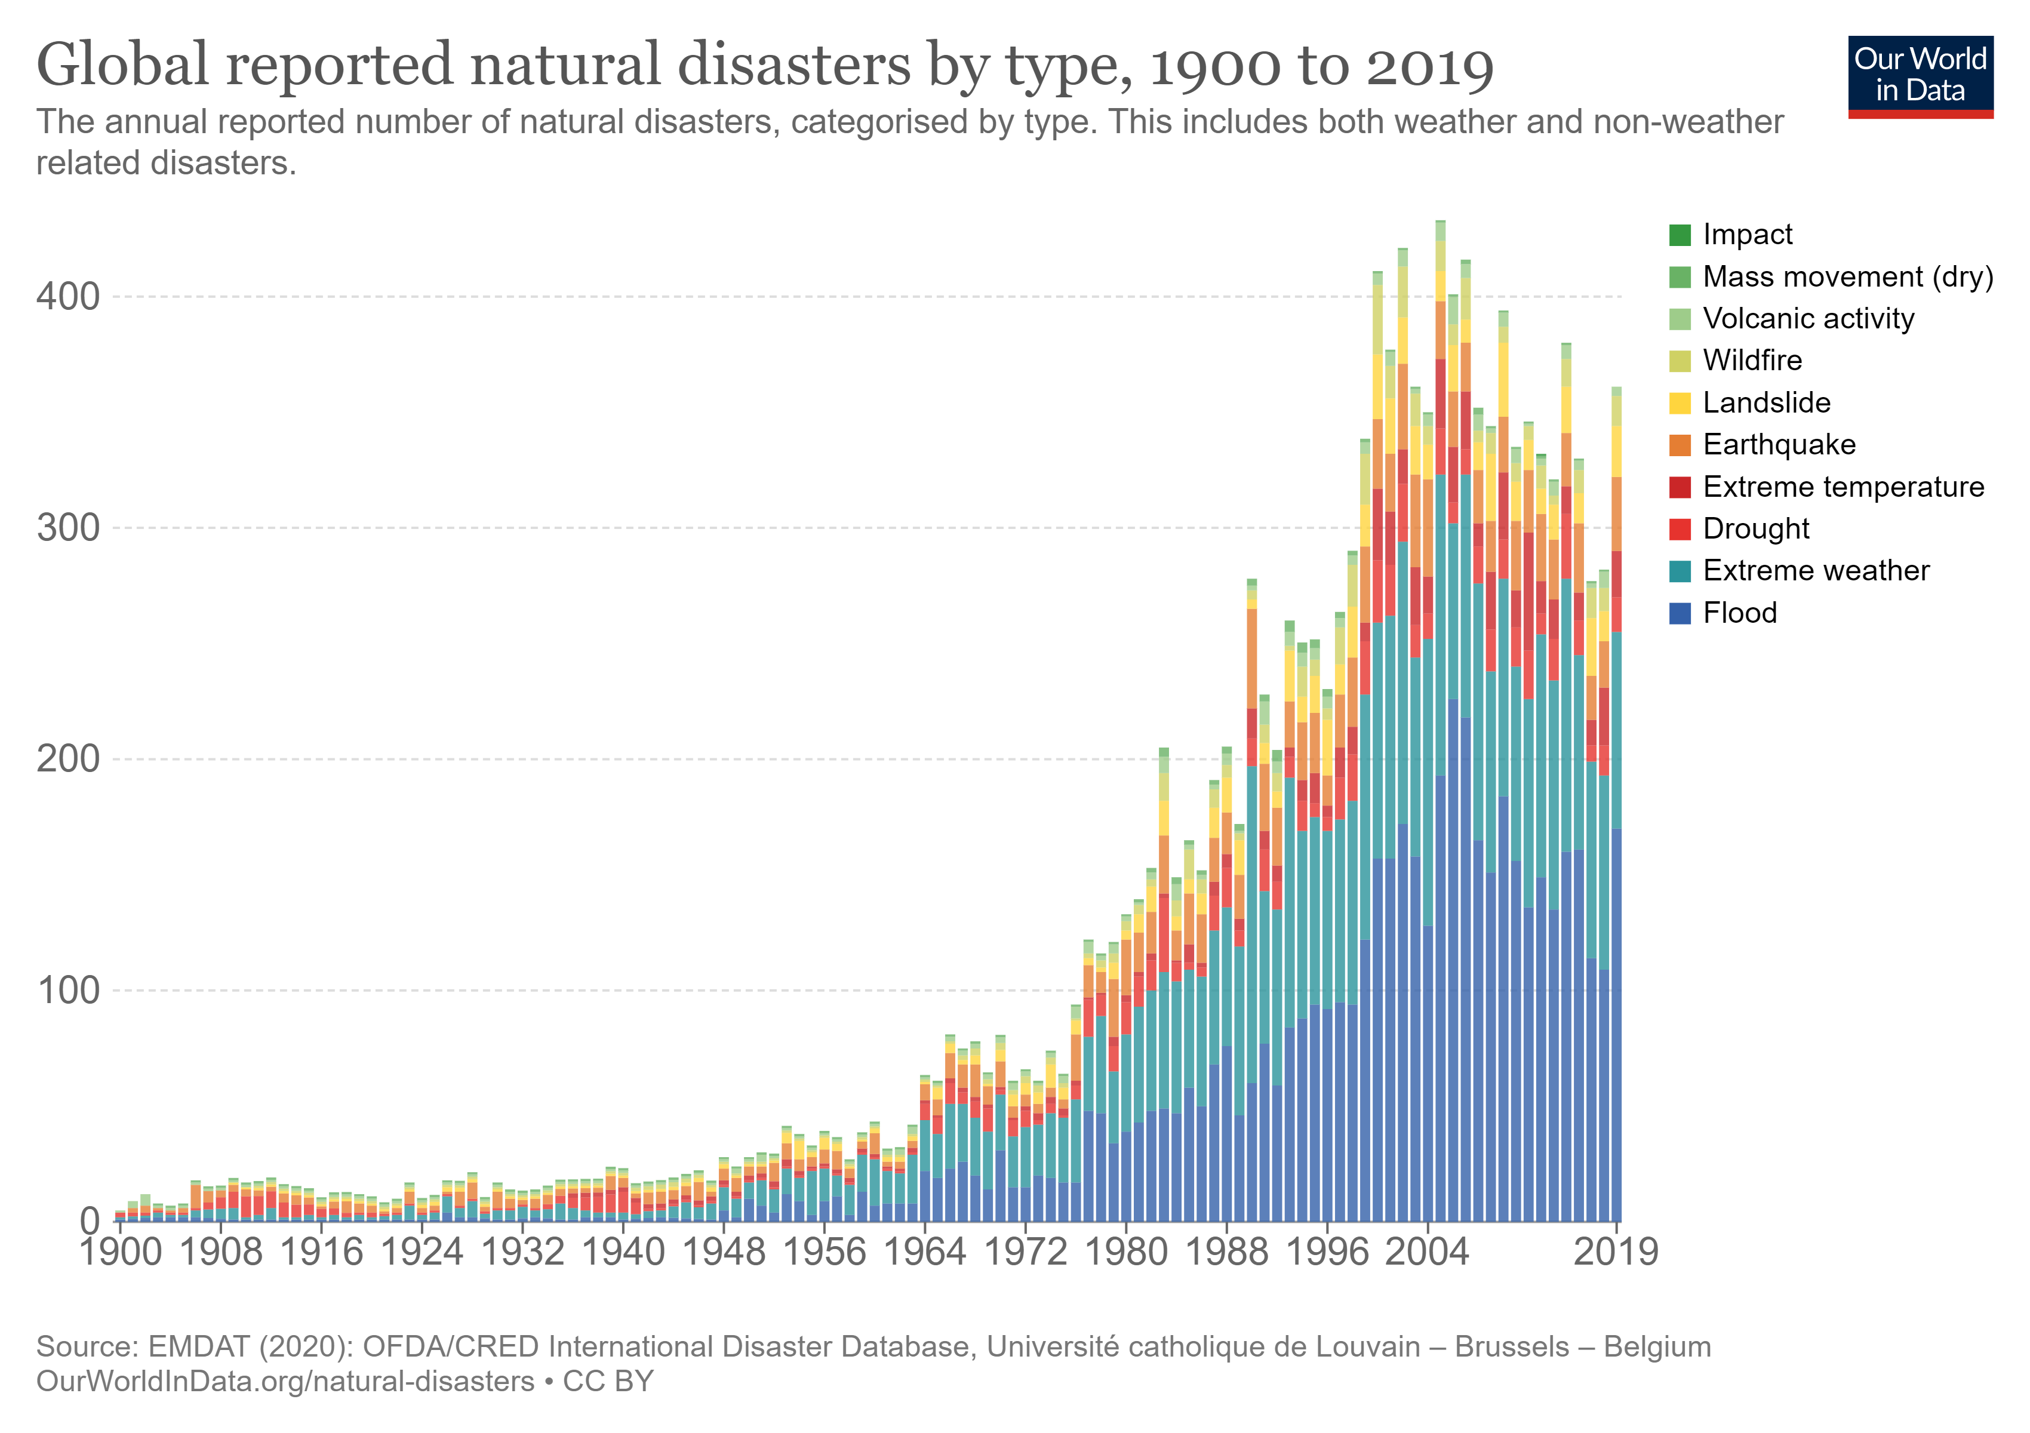
I. Introduction
Background
Natural disaster are events that result from natural processes.
27,146 reported natural disasters from 1900 – 2020.*
Risks of natural disasters can be reduced by developing a deep learning model to detects disaster and alert the communities.
* data from https://ourworldindata.org/natural-disasters
1

Slide 3
I. Introduction
Background
Convolutional neural network (CNN) is able to learn more meaningful insights from images.
The growing popularity of CNN have paved the way for new computer vision applications.
One specific area would be disaster management.
Monitoring these disasters at large-scale coverage would require high-performance hardware to run the deep learning model.
In the paper, we propose a lightweight disaster classification model that identifies four types of natural disasters and one non-disaster class.
2

Slide 4
I. Introduction
Aim and Objectives
We consolidate a dataset which consists of natural disaster and non-disaster images.
We employ transfer learning approach to output a disaster classification model before optimizing the model with OpenVINO.
We provide benchmark results for both training and inference stages, which sheds more insights into the actual implementation performance.
3

Slide 5
II. Related Work
Literature Review
Many works have focused on CNN instead of machine learning (ML). [6]
Authors in [7] consolidated a substantial amount of dataset for disaster management application, but did not consider disaster event classification.
In [8], the authors utilized various CNN architectures in identifying survivors in debris, but the annotated images were focused on earthquake-hit regions only.
[6] R. R. Arinta and E. Andi W.R., "Natural Disaster Application on Big Data and Machine Learning: A Review," 2019 4th International Conference on Information Technology, Information Systems and Electrical Engineering (ICITISEE), 2019, pp. 249-254, doi: 10.1109/ICITISEE48480.2019.9003984.
[7] B. Mishra, D. Garg, P. Narang and V. Mishra, "Drone-surveillance for search and rescue in natural disaster", Computer Communications, 2020.
[8] Chaudhuri N, Bose I (2020) Exploring the role of deep neural networks for post-disaster decision support. Decis Support Syst 130:113234. https://doi.org/10.1016/j.dss.2019.113234
4

Slide 6
II. Related Work
Literature Review
The work in [9] focused on classifying disaster events after collecting over 7000 natural disasters images from social media platforms.
The authors in [10] further divided disaster-related images into four different categories, namely disaster type detection, informativeness, humanitarian and damage severity.
[9] L. Ahmed, K. Ahmad, N. Said, B. Qolomany, J. Qadir and A. Al-Fuqaha, "Active Learning Based Federated Learning for Waste and Natural Disaster Image Classification," in IEEE Access, vol. 8, pp. 208518-208531, 2020, doi: 10.1109/ACCESS.2020.3038676.
[10] F. Alam, F. Ofli, M. Imran, T. Alam and U. Qazi, "Deep Learning Benchmarks and Datasets for Social Media Image Classification for Disaster Response," 2020 IEEE/ACM International Conference on Advances in Social Networks Analysis and Mining (ASONAM), 2020, pp. 151-158, doi: 10.1109/ASONAM49781.2020.9381294.
5

Slide 7
II. Related Work
Literature Review
Apart from disaster-related images, text messages also contains critical information.
A multimodal fusion model, which combines both visual and textual features to classify relevant disaster images, have been developed by [11].
However, all the studies focused on accuracy measurement, and uses high-end graphics processing unit (GPU).
Deploying these trained models directly on resource-constrained edge devices remains a challenging task [12].
[11] Zou, Z.; Gan, H.; Huang, Q.; Cai, T.; Cao, K. Disaster Image Classification by Fusing Multimodal Social Media Data. ISPRS Int. J. Geo-Inf. 2021, 10, 636
[12] Z. Jiang, T. Chen, and M. Li, “Efficient Deep Learning Inference on Edge Devices”, in Proceedings of ACM Conference on Systems and Machine Learning (SysML’18), 2018.
6

Slide 8
II. Related Work
Literature Review
On the contrary, the authors in [13] assessed the CNN performance in terms of accuracy and speed, and their proposed model achieve 9 frames per second (FPS).
But they did not explore the potential of neural network optimization on target devices at the inference stage.
Performance acceleration can be done on open-source CNN model inference engine called OpenVINO Toolkit [14].
[13] C. Kyrkou and T. Theocharides, "Deep-learning-based aerial image classification for emergency response applications using unmanned aerial vehicles", Proc. IEEE Conf. Comput. Vision Pattern Recognit. Workshops, pp. 517-525, Jun. 2019.
[14] Docs.openvinotoolkit.ai. 2022. Model Optimizer Developer Guide. [online] Available at: <https://docs.openvino.ai/latest/openvino_docs_MO_DG_Deep_Learning_Model_Optimizer_DevGuide.html> [Accessed 21 March 2022].
7

Slide 9
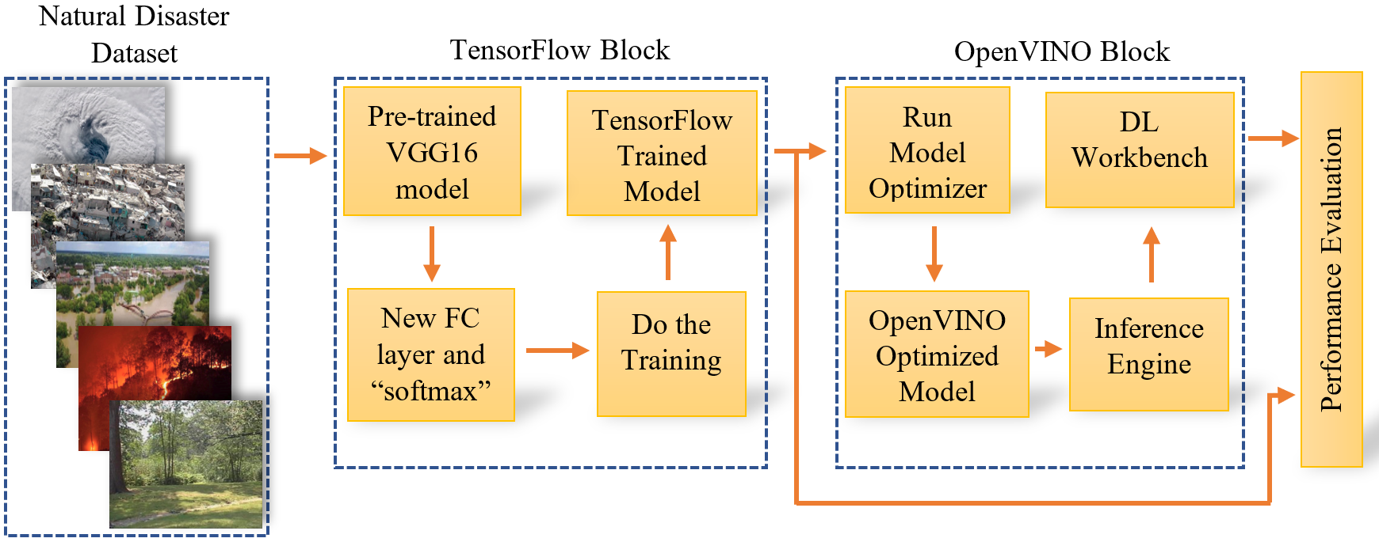
III. DL Model Deployment
Overview
Figure 1: Overview of the project
8

Slide 10
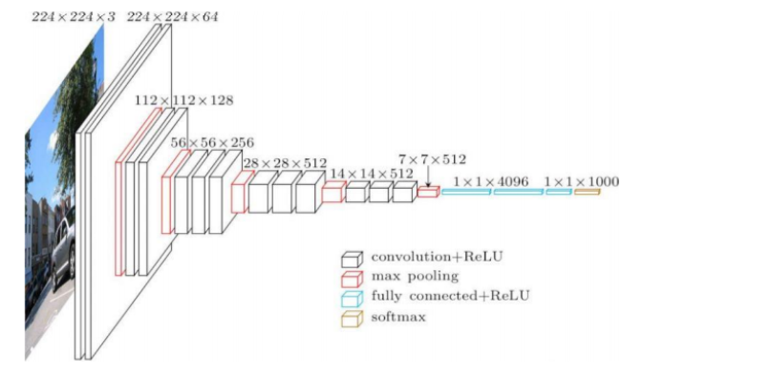
III. DL Model Deployment
A. Model Training
Data Split for Disaster Classification
Disaster Label | Train (67.5 %) | Validation (7.5 %) | Test (25 %) | Total
Cyclone | 599 | 78 | 251 | 928
Earthquake | 923 | 86 | 341 | 1350
Flood | 741 | 80 | 252 | 1073
Wildfire | 724 | 68 | 285 | 1077
Non-Disaster | 1821 | 223 | 652 | 2696
Table 1: Summary of the dataset
Parameters and its Values for Fine-Tuning the VGG16 Model
Parameter | Value
Batch Size | 32
Number of Steps | 8
Epoch | 48
Min Learning Rate | 1e-6
Max Learning Rate | 1e-4
Table 2: Summary of the parameters
9

Slide 11
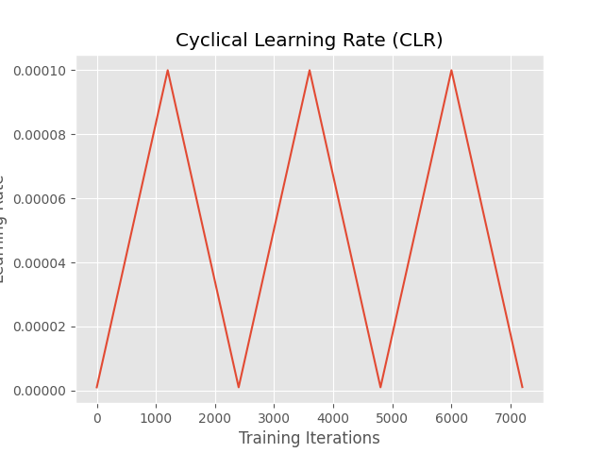
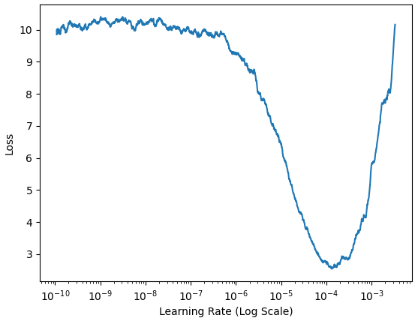
III. DL Model Deployment
A. Model Training
Figure 2: Learning rate range test
Figure 3: CLR plot
10

Slide 12
III. DL Model Deployment
B. Model Optimization
Obtain the trained model
Transfer learning approach.
Fine-tunings.
Freeze the model
Save and freeze the model’s weights.
Convert the model to a compatible format
Conversion of the trained model into Intermediate Representation (IR) format via OpenVINO’s model optimizer.
.
python3 mo_tf.py --saved_model_dir <model-path> --output_dir <output-dir> --input_shape [1,224,224,3]
11

Slide 13
III. DL Model Deployment
B. Model Optimization
Execute the inferences
Uses OpenVINO’s Inference Engine.
Run via a custom Python script.
Evaluate the performance
TensorFlow model use classification_report function.
Optimized model use DL Workbench.
Precision of TensorFlow model: FP32.
Precision of optimized model: FP32, FP16, INT8.
12

Slide 14
III. DL Model Deployment
C. Model Inference
2 inference modes.
Synchronous inference: allowing only one image to be processed per inference.
Asynchronous inference: speeds up the process by inferencing one image while pre-processing the next image.
By default, the inference model in the Inference Engine of OpenVINO uses asynchronous mode.
13

Slide 15
IV. Experimental Results
System specifications
Intel i7-10710U 6-core processor
64 GB of RAM
1 TB of SSD
Ubuntu 18.04 LTS
TensorFlow 2.0
Intel UHD graphics
OpenVINO version 2021.4
Training phase
Inference phase
14

Slide 16
IV. Experimental Results
Training Performance
25 % test dataset (1781 images) for the performance evaluation.
93 % accuracy, throughput average 7.70 FPS.
The same test dataset is used in the performance evaluation of the optimized model.
Table 3: Results of TensorFlow model
Results of TensorFlow Natural Disaster Classification Model
Disaster Class | Precision | Recall | F1-Score | Support
Cyclone | 96% | 98% | 97% | 251
Earthquake | 94% | 92% | 93% | 341
Flood | 84% | 90% | 87% | 252
Wildfire | 93% | 93% | 93% | 285
Non-Disaster | 96% | 93% | 95% | 652
15

Slide 17
IV. Experimental Results
Inferences Performance
For CPU, INT 8 precision model has a 80.8 % higher FPS and 0.119 % higher accuracy as compared to FP 32 precision model.
The FP 16 precision model is not available due to the limitation of DL workbench and the particular Intel CPU used in this study.
Table 4: Results of the optimized model
Results of OpenVINO Optimized Model - CPU
Precision | FP 32 | FP 16 | INT 8
Throughput (FPS) | 11.81 | - | 21.35
Accuracy (%) | 92.19 | - | 92.30
16

Slide 18
IV. Experimental Results
Inferences Performance
For GPU, FP 16 precision model has a 162 % higher FPS while sacrificing 0.065% accuracy as compared to FP 32 precision model.
The INT 8 precision model is not supported on the integrated GPU.
Table 5: Results of the optimized model
Results of OpenVINO Optimized Model - GPU
Precision | FP 32 | FP 16 | INT 8
Throughput (FPS) | 9.15 | 23.93 | -
Accuracy (%) | 92.19 | 92.13 | -
17

Slide 19
IV. Experimental Results
Performance Comparison
The comparison is done on the TensorFlow model and the optimized models.
On GPU hardware, FP 16 precision model achieves a substantial improvement of 211 % in throughput while only sacrificing 0.935 % accuracy.
The comparisons show that the OpenVINO optimized models have a better performance enhancement over the TensorFlow’s model.
Table 6: Performance comparison based on TensorFlow model
Model | Optimized FP 32 model | Optimized INT 8 model
Throughput | + 53.4 % | + 177 %
Accuracy | - 0.871 % | - 0.753 %
18

Slide 20
IV. Experimental Results
Additional performance parameters in DL Workbench
DL Workbench is able to display the results of the performance summary of the model.
Figure 4: Screenshot of performance summary in DL Workbench
19

Slide 21
V. Conclusion and Future Lines
Contributions of this study:
Consolidating a balanced natural disaster dataset.
Trained a new natural disaster classification model to classify natural disaster and non-disaster scenarios.
Addressed the need for powerful hardware by deploying the trained model into the OpenVINO platform.
Evaluated the performance of the trained model and concluded that the model performs significantly better in the OpenVINO environment as compared to the TensorFlow environment.
20

Slide 22
V. Conclusion and Future Lines
Future Works:
Power consumption of the model running in different environments can be measured and it will be used as one of the performance metrics.
21

Slide 23
Acknowledgement
This work is the output of the ASEAN IVO (http://www.nict.go.jp/en/asean_ivo/index.html) project titled “Context-Aware Disaster Mitigation using Mobile Edge Computing and Wireless Mesh Network” and financially supported by NICT (http://www.nict.go.jp/en/index.html).
22

Slide 24
Questions and Answers
Q & A
23

