Slide 1
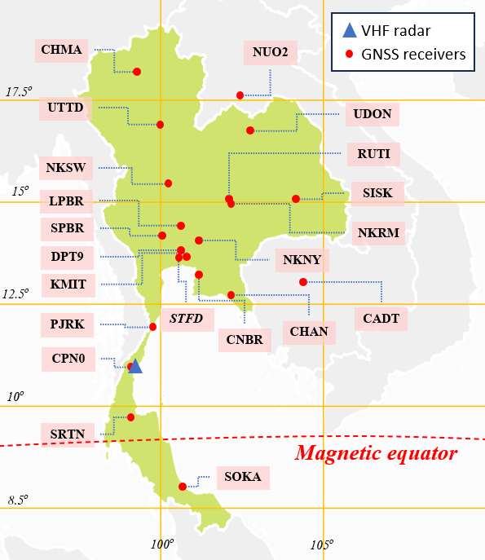
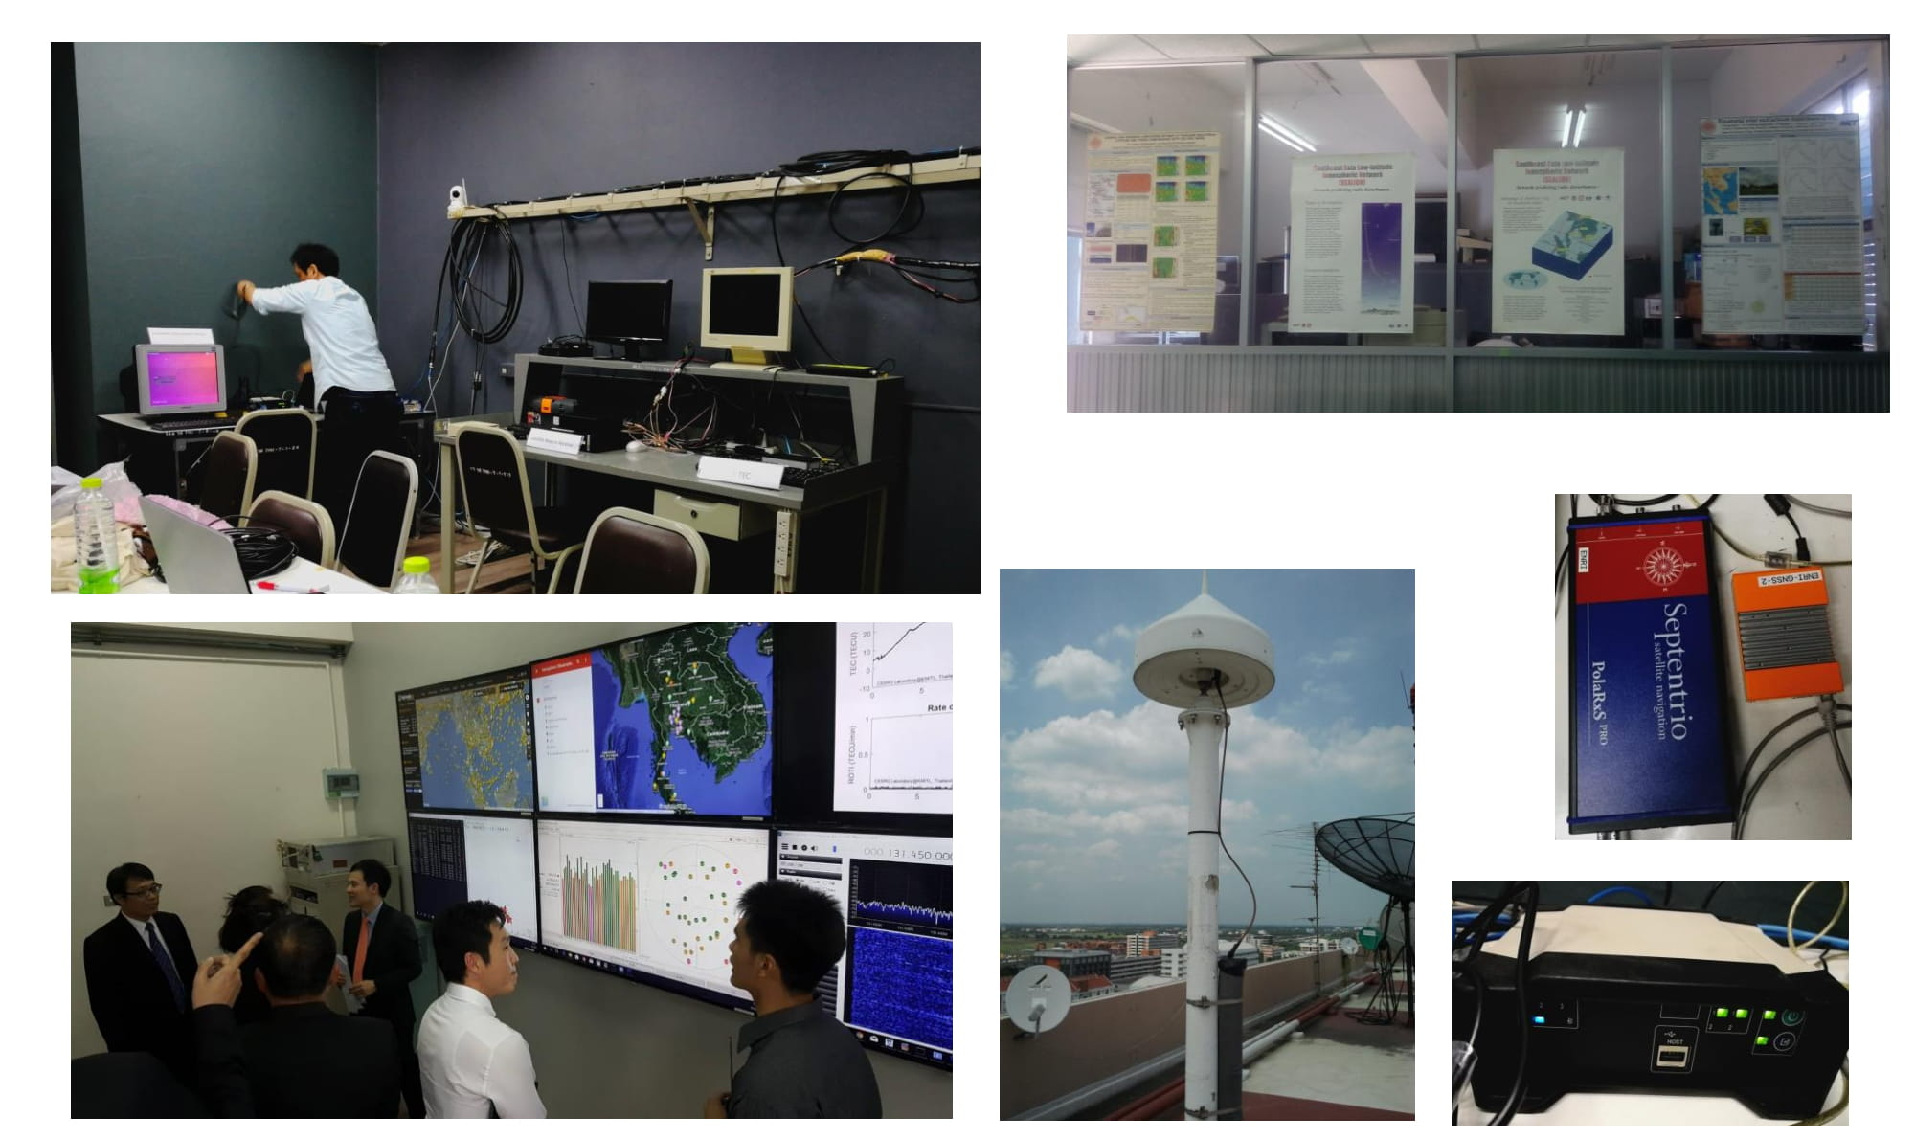
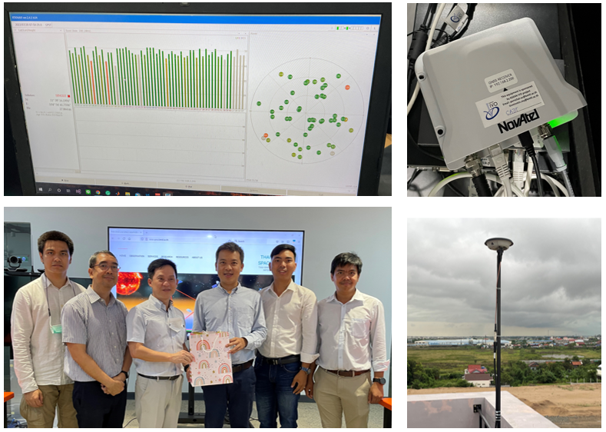
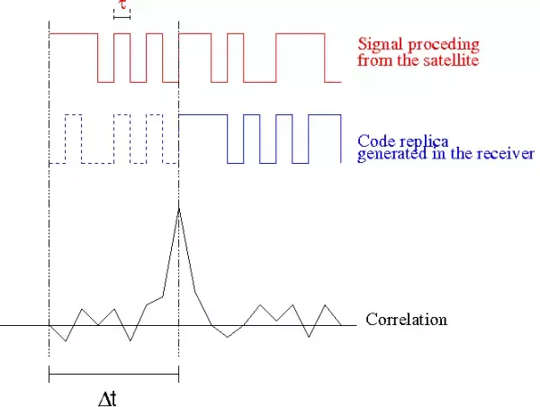
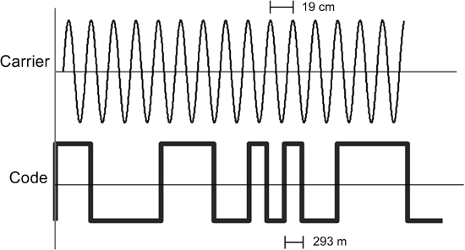
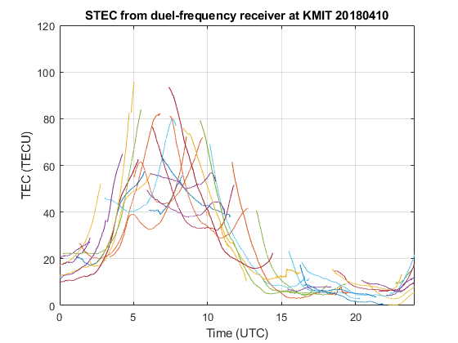
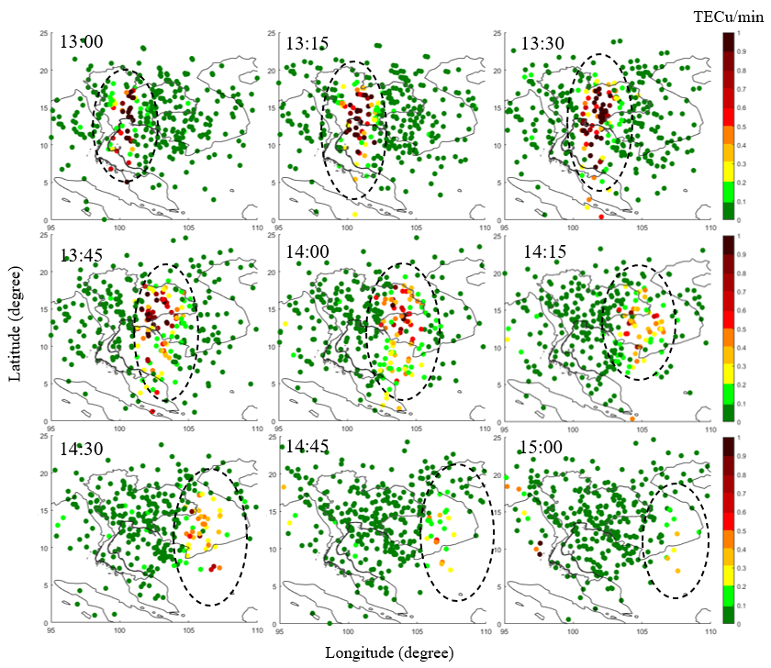
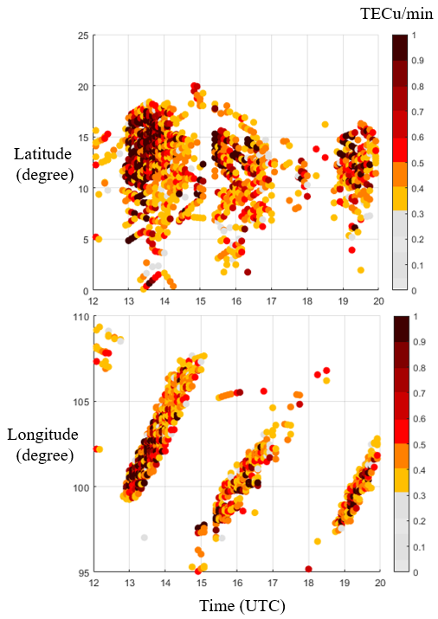
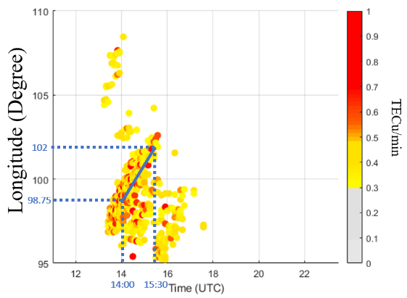
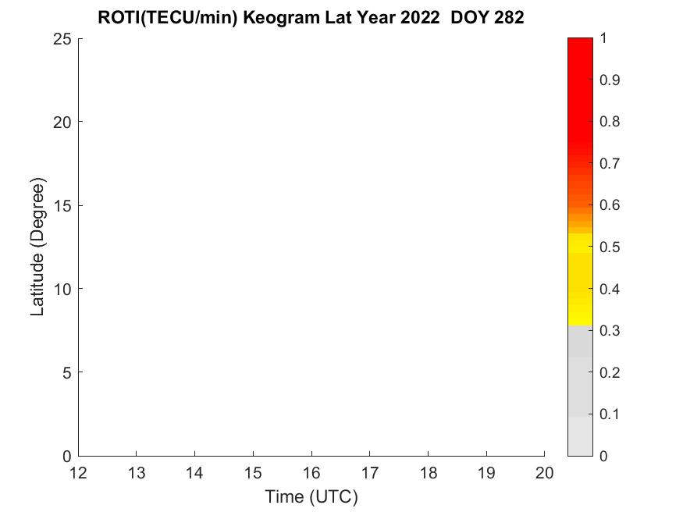
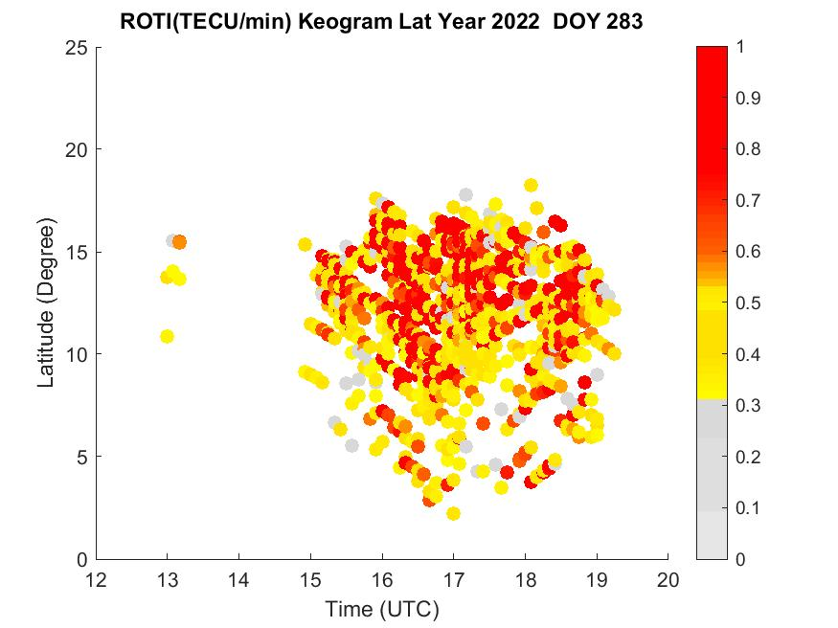
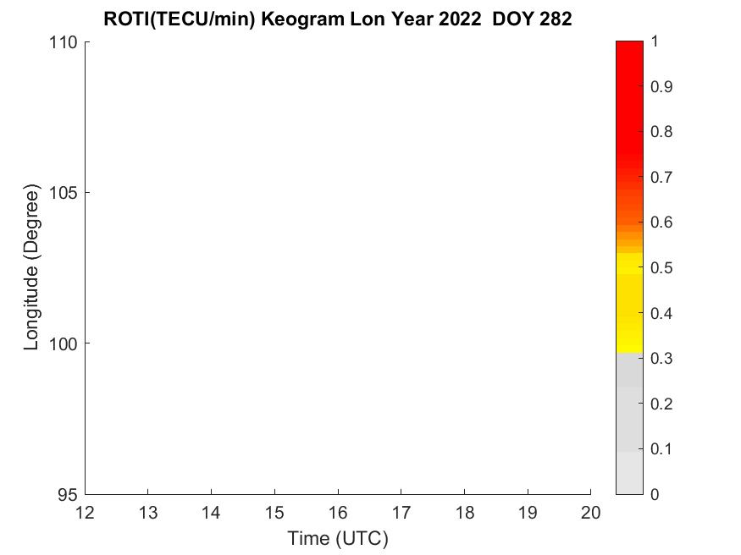
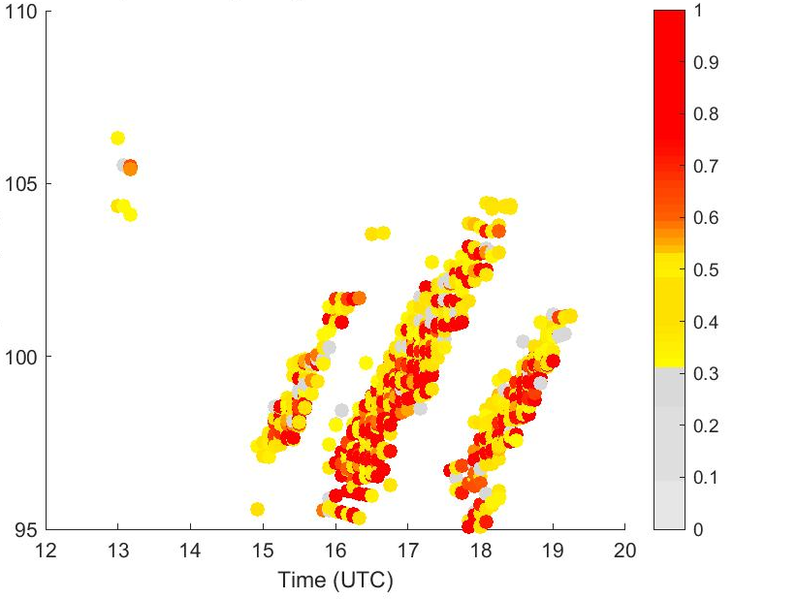
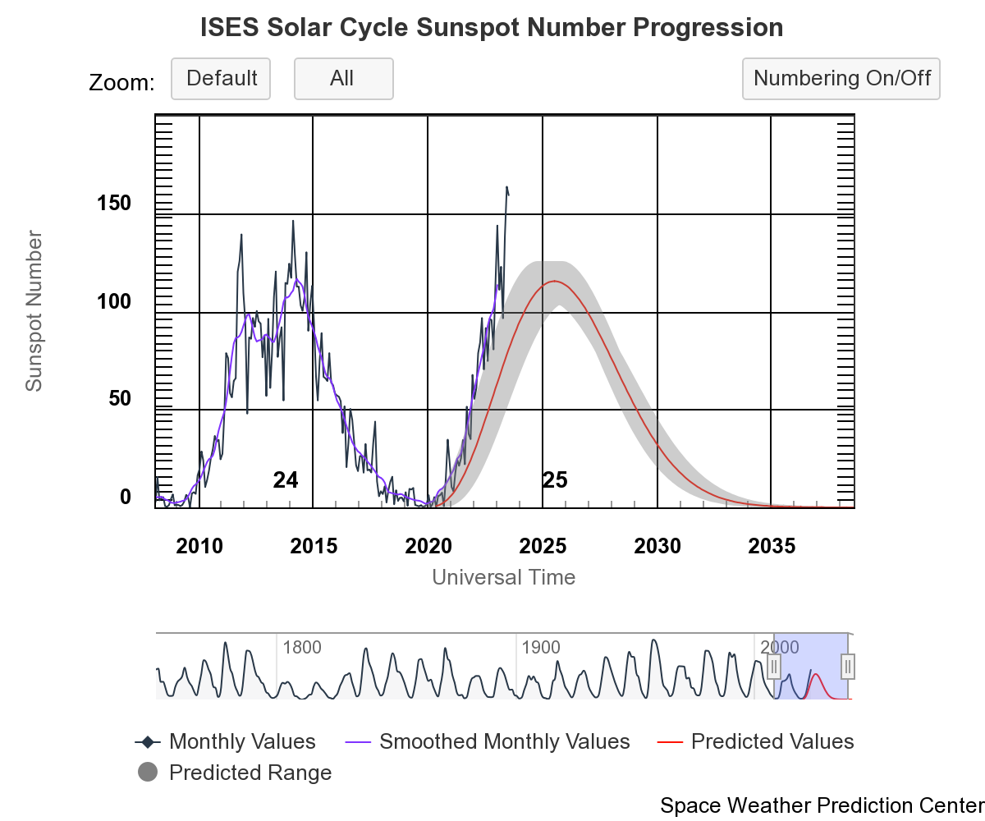
Near Real-time Equatorial Plasma Bubble Monitoring System using GNSS at the Low Latitude Region in ASEAN
N.Tongkasem (1), L.M.M. Myint* (1), P. Supnithi(1), K. Hozumi(2), D. Lakanchanh(3), and T. Nhem(4)
* Presenter email: linminmin.my@kmitl.ac.th
Introduction
Data sources and Results
Monitor EPB occurrences using daily ionospheric total electron content (TEC) and rate of TEC change index (ROTI) map and keograms,
Data source
20 GNSS stations on the Thailand region and nearby
Develop a near real-time EPB monitoring system using Global Navigation Satellite System (GNSS) data from the receiver stations in Thailand as well as the stations in Lao and Cambodia.
King Mongkut institute of Technology Ladkrabang (KMITL)
Generate (every 15 minutes) 2D-maps (latitude and longitude) of TEC, ROTI covering the low latitude region from latitudes of N 0º from N 25º, and the longitudes from E 95º to E 110º.
Detect the occurrence of EPB from the generated 2D-maps using image processing of AI in future.
Methods
Cambodia Academy of Digital Technology (CADT)
TEC calculation
TEC can be calculated from pseudorange, which recorded from code or carrier phase measurement.
Ionospheric delay can be measured from TEC
1
Code pseudorange
2
Carrier phase pseudorange
University of Laos (NUO2)
(1)
Fig. 1. The pseudorange is calculated from the delay time of the code signal correlation
Fig. 2. The pseudorange is calculated from the carrier phase tacking
TEC map
Parameters
(2)
Ionospheric delay
(3)
The amount of electron density between the satellite and the receiver, expressed in TECu (1 TECu = 10^16 electrons/m2).
(4)
(5)
real distance
(4)-(2)
(3)-(5)
receiver hardware delay
ROTI 2D map
satellite hardware delay
Remove: Hardware delay, ambiguity and noise
ROTI keogram
light speed
recorded code pseudorange
recorded carrier-phase pseudorange
Slant Total Electron Content
integer ambiguity
phase
Figure. The observed TEC on 10/04/2018 at KMIT station.
noise and multipath
ROTI calculation
EPB speed estimation
the slant differential TEC or rate of TEC, ROT in (6) is determined by calculating the change of slant TEC between consecutive intervals time 1 minute.
The direction and speed of the EPBs can be estimated using the zonal drift velocities of the EPBs shape of ROTI keogram.
(6)
The ROTI in unit of TECu/min is computed from the standard deviation of ROT
Quiet vs Disturb
(7)
ROTI latitude keogram
ROTI longitude keogram
Doy 282
Doy 283
Doy 282
Doy 283
Solar 25 [space weather prediction center, NOAA]
The ascending phase of the Solar Cycle 25 are higher than the predicted sunspot number value (SSN), and higher than the peak of SSN in Solar Cycle 24.
EPB Statistics in 2022
Flowchart
RESULTS
2D TEC map
Conclusions
GNSS data from GNSS stations
TEC estimation
In this study, we examine the spatial and temporal changes of EPBs using the spatial ROTI map, latitudinal/longitudinal keogram plots developed from the GNSS receiver network in ASEAN’s northern hemisphere low latitudes.
Preprocessing
Cycle slip correction
Low Elevation angle cut off
ROTI estimation
2D ROTI map
ROTI keogram
According to the results, the location of the EPB can be detected by the spatial ROTI maps and their spatial-temporal variation is monitored using the keogram plots for forecasting their occurrence and movement.
Publish on the Website: http://iono-gnss.kmitl.ac.th/
Acknowledgement
School of Engineering, King Mongkut’s Institute of Technology Ladkrabang, Bangkok 10520, Thailand
National Institute of Information and Communications Technology, Koganei, Tokyo, 184-8795, JAPAN
Faculty of Engineering, National University of Laos, Lao PDR
Institute of Digital Research and Innovation, Cambodia Academy of Digital Technology, 12252, Cambodia
The ASEAN IVO (http://www.nict.go.jp/en/asean_ivo/ index.html) project, [GNSS and Ionospheric Data Products for Disaster Prevention and Aviation in Magnetic Low- Latitude Regions (Phase II)], was also involved in the production of the contents of this work and financially supported by NICT (http://www.nict.go.jp/en/index.html).

